Slide 1
Introduction to user experience(UX)
Ms. Iqra Shahzad
Department of Software Engineering, NUML, Islamabad.

Slide 2
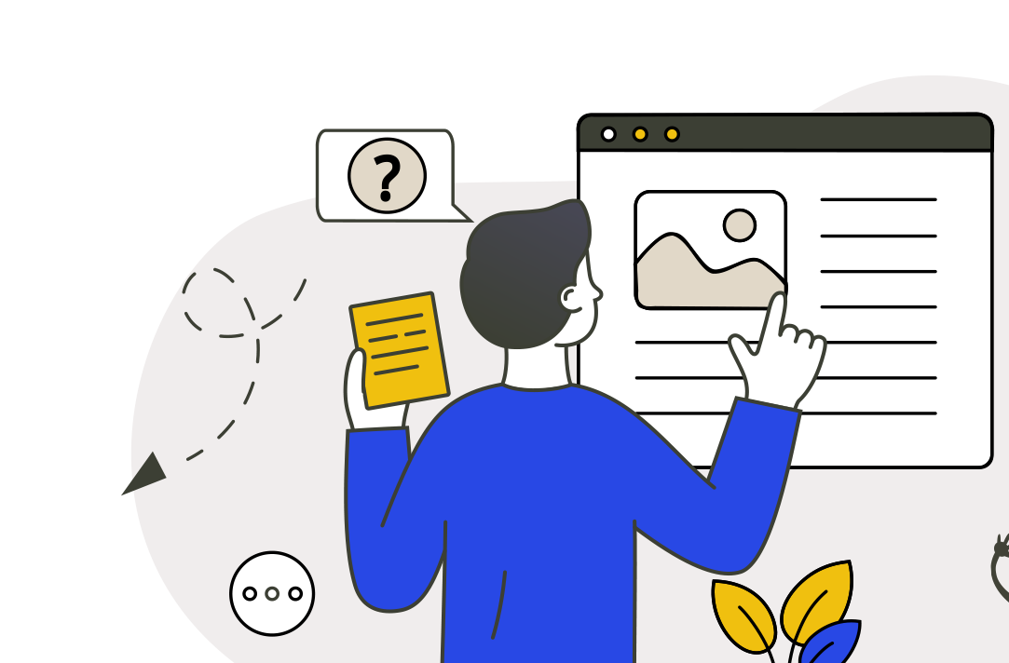
What is User Experience?
User Experience, often abbreviated as UX, refers to the overall experience a user has while interacting with a product, system, or service. This includes not just the usability and functionality of the product, but also the emotions and perceptions that the user feels during and after their interaction.

Slide 3
How to improve the user experience?
Understand your users:
Ensure user centered design
Test usability
Aim for accessibility
Collect user feedbacks.

Slide 4
Interactive systems
Interactive systems are computers that accept human input. Humans provide commands or data to computers by typing or by gestures.
Web app services
Mobile phone apps
Wearable devices
IOT devices
Augmented and virtual reality

Slide 5
Variety of UX
Number of interactive services and products
iPhone
Nest home control
Burberry
iRobo-Q
Facebook
Device ecology
Interesting and challenging domain
Notes:
Google Nest is a line of smart home products including smart speakers, smart displays, streaming devices, thermostats, smoke detectors, routers and security systems including smart doorbells, cameras and smart locks

Slide 6
Notes:
NEST – Ac controller
interaction with ease.

Slide 7
Notes:
Eye tracking

Slide 8
Difference between UI and UX.
UI to the screens, buttons, toggles, icons, and other visual elements that you interact with when using a website, app, or other electronic device.
UX refers to the entire interaction you have with a product, including how you feel about the interaction.

Slide 9
Concerns of UX designer
Design
❑What is design and how should you do it
Technologies
❑Interactive systems, products, devices, components
People
❑Who will use the systems
Activities and contexts
❑Users’ goals and environment

Slide 10
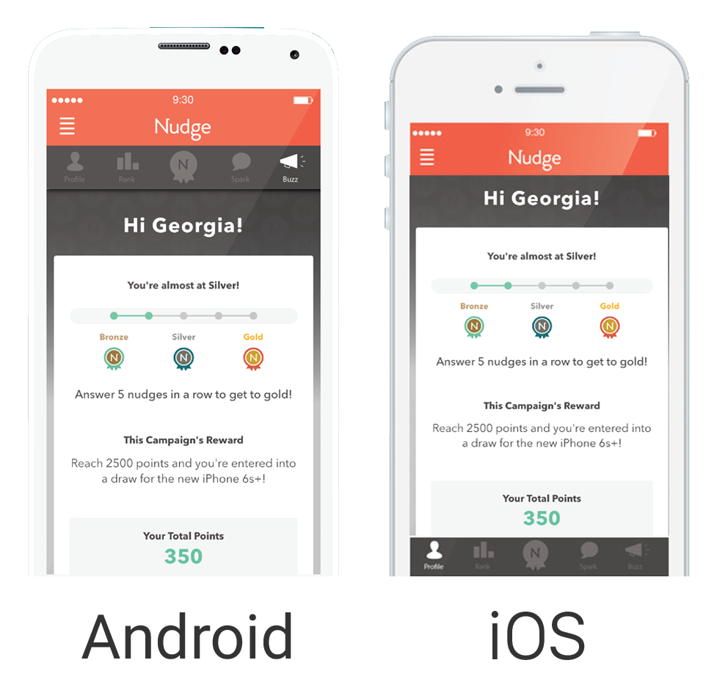

Slide 11
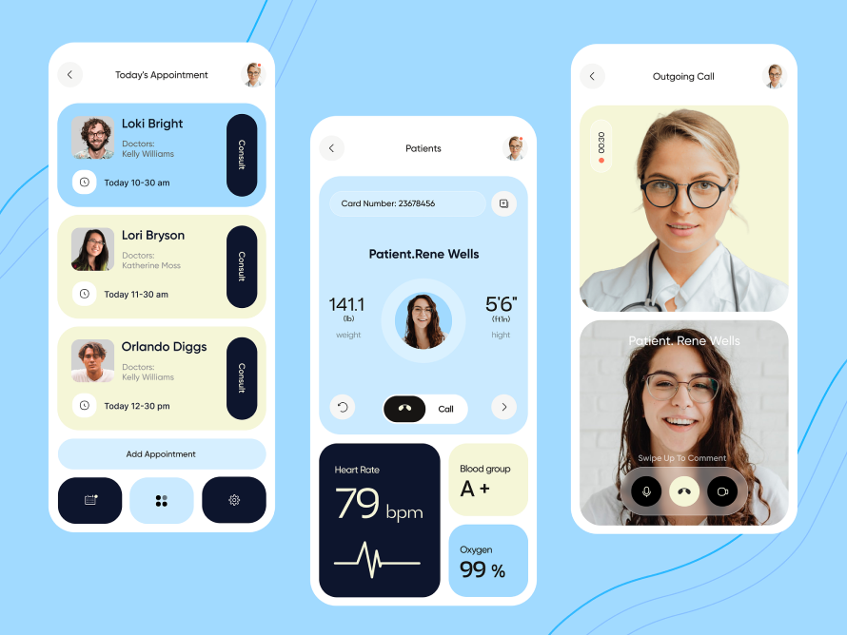
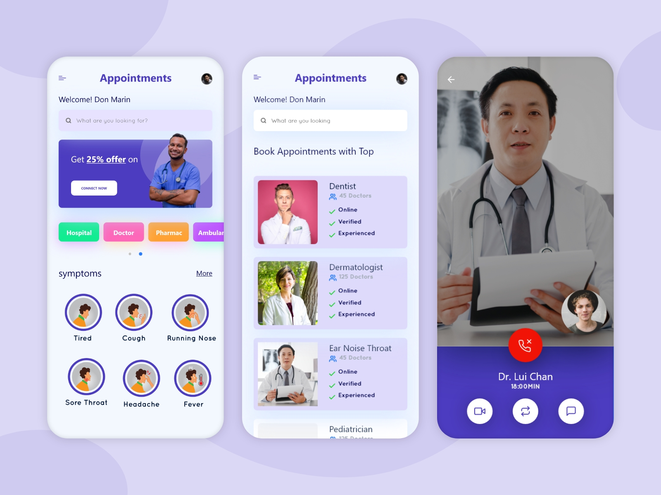

Slide 12
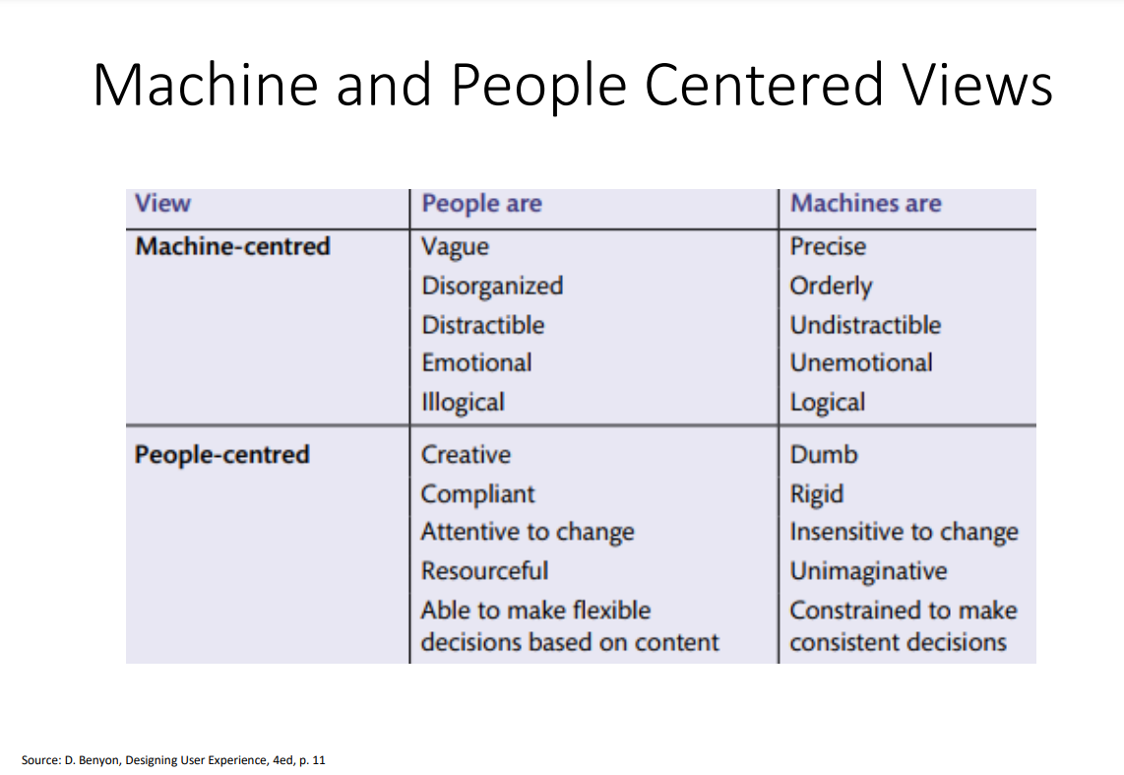

Slide 13
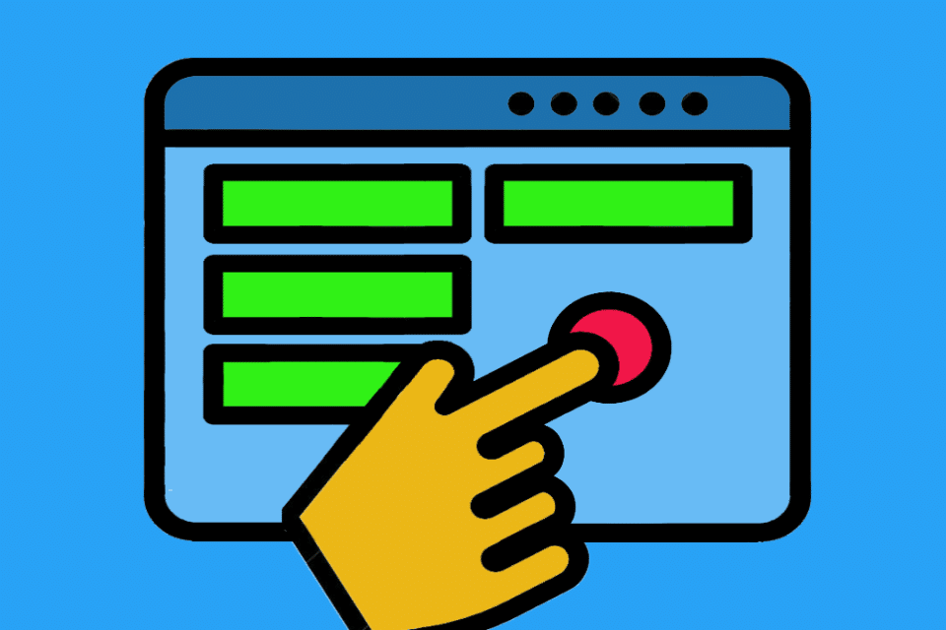
User interface
The interaction between man and machine
Machines are part of our lives. They facilitate our work and our interaction.

Slide 14
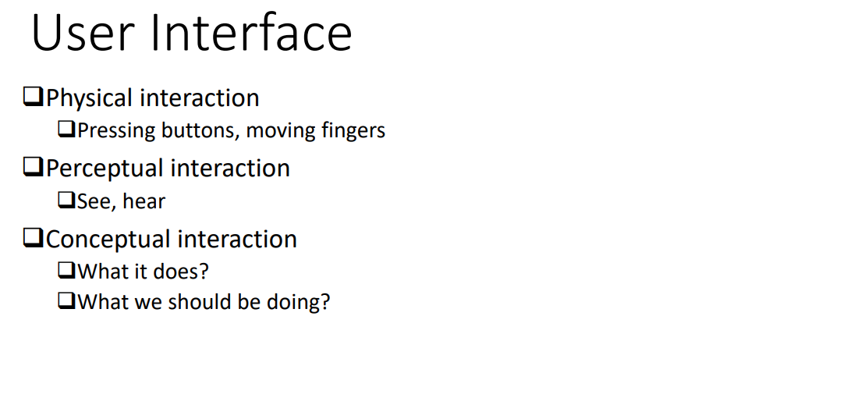
Notes:
With interface we can have three types of interations

Slide 15
The way user interfaces work – sometimes also called man-machine interface (MMS) or human machine interface (HMI) – varies depending on the machine or system, the product or the software.
various examples of user interfaces:
We unlock our smartphone by fingerprint, facial recognition or numerical code.
We use a remote control to change TV stations on the television,
we activate functions in software programmes via individual menu items,
we use the control panel to set the duration of a dishwasher cycle
and we communicate our wishes to virtual voice assistants by voice.

Slide 16
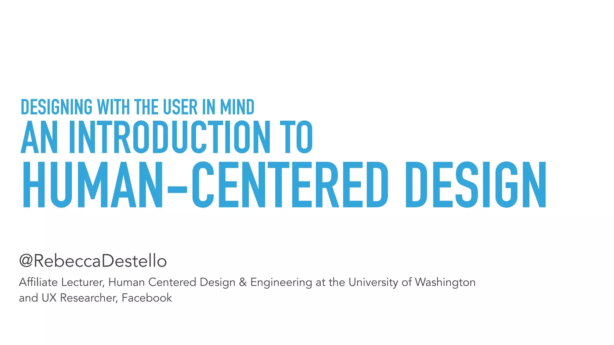

Slide 17
Being Human-Centered
Thinking about what people want to do rather than what the technology can do(a human centered approach)
Designing new ways to connect people with people
Involving people in the design process
Designing for diversity

Slide 18
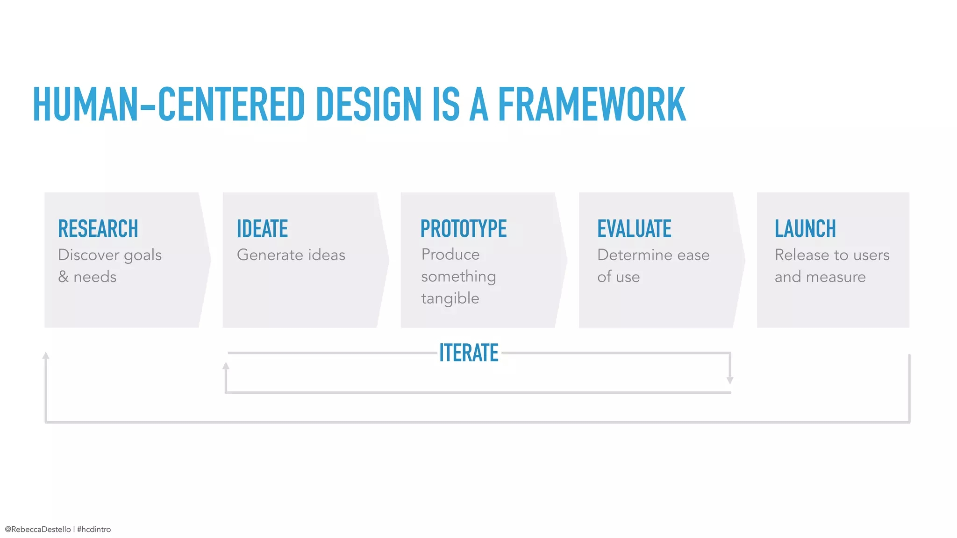

Slide 19
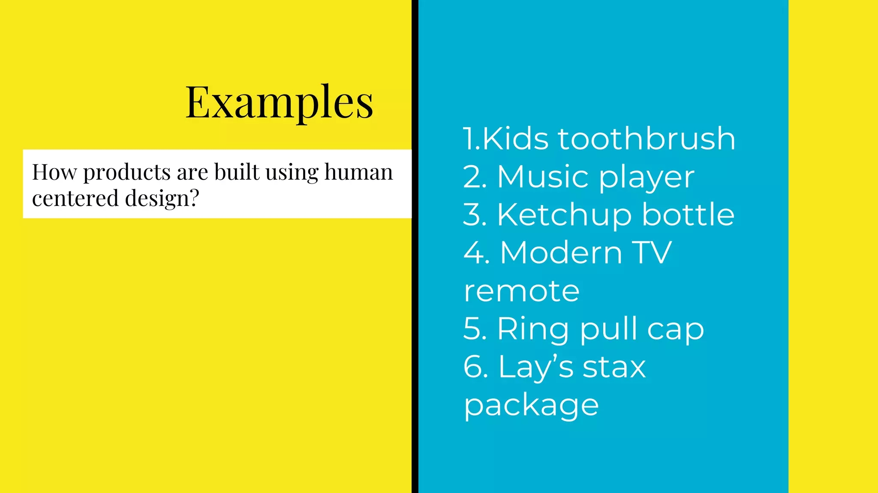

Slide 20
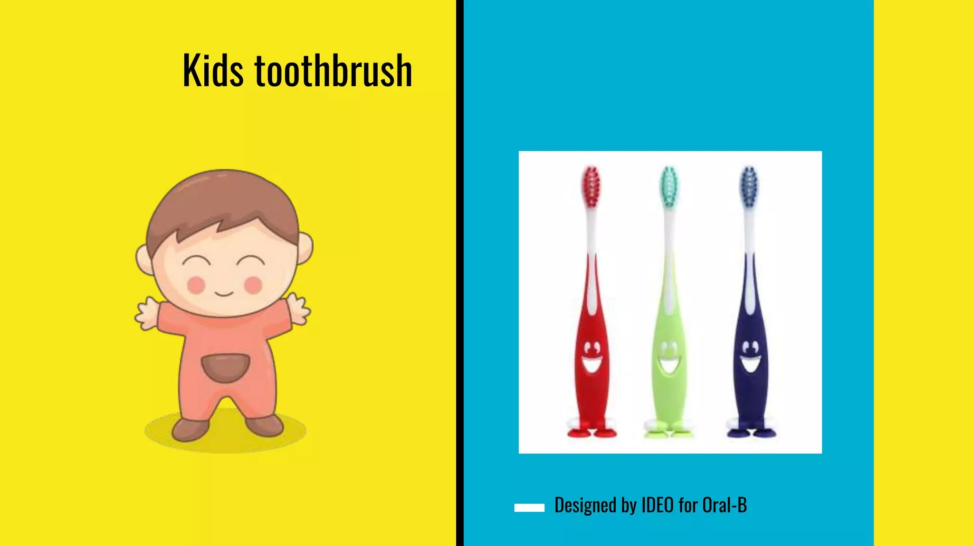
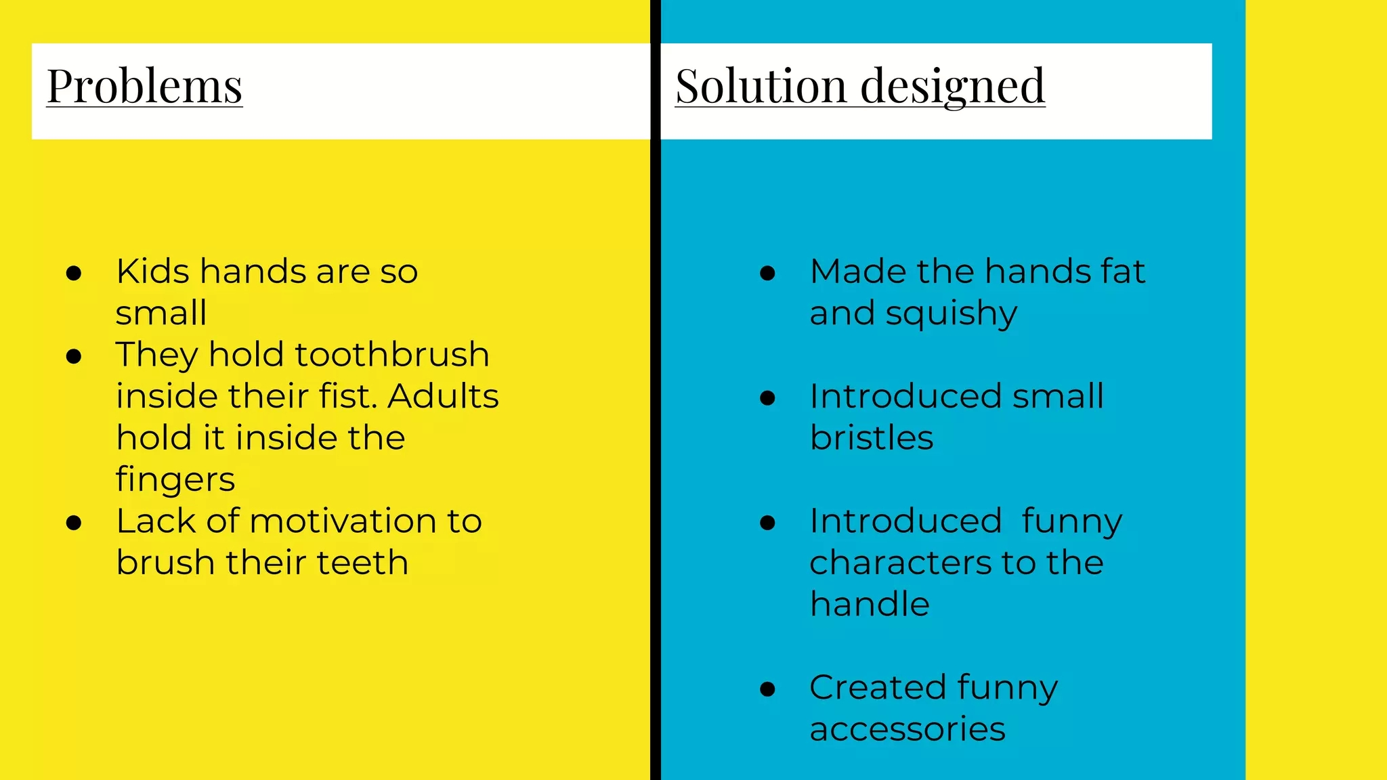

Slide 21
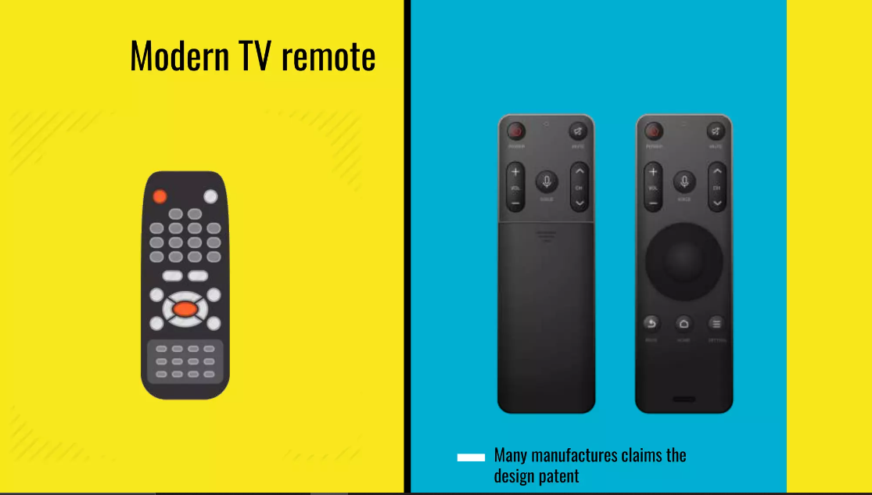
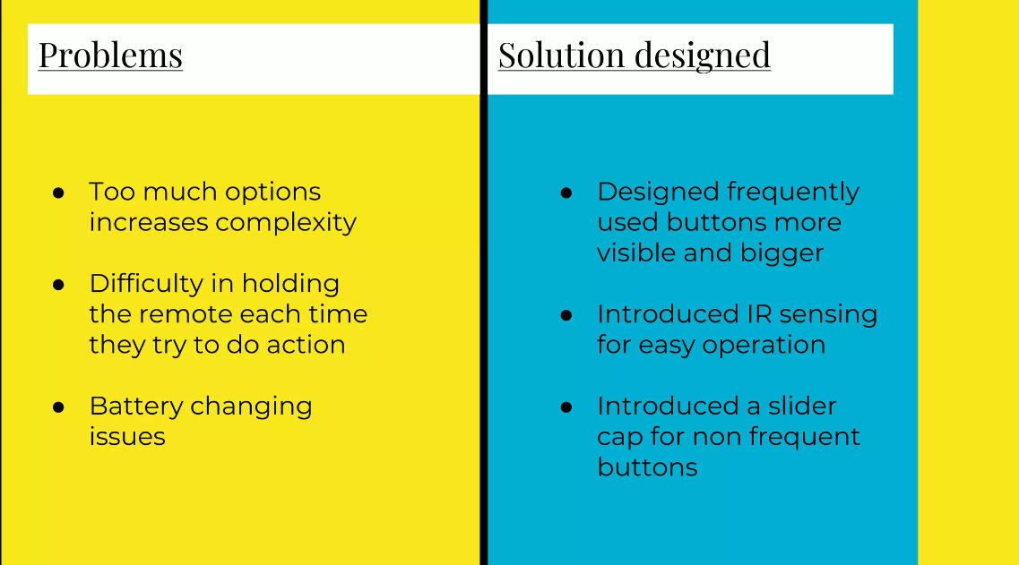

Slide 22
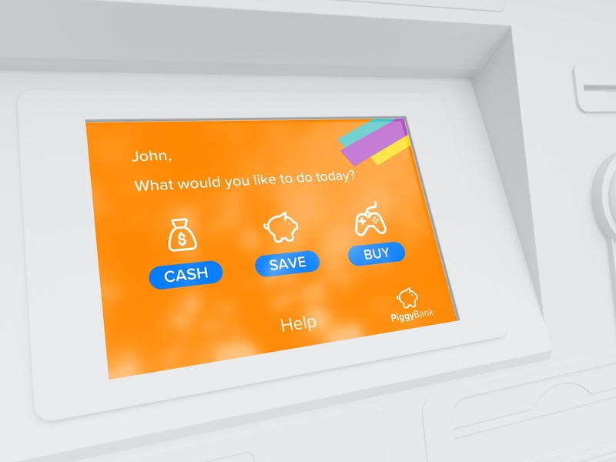

Slide 23
❑Return on investment
❑225% sales increase by turning ‘browsers’ into ‘buyers’ ❑Safety
❑Plane and train disasters
❑Ethics
❑Quality of people’s lives
❑Sustainability
❑Environment friendly design
Why being Human-Centered
is Important

Slide 24
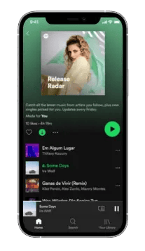
Notes:
Spotify succeeded by empathizing with their users’ struggle to pay for music from disparate sources and created a solution we could all embrace. Thanks to Spotify, users can get all their music in one place for one monthly fee. I’m willing to pay more for that kind of tailored, customized, helpful service.

